Slide 1
Royalty Free Clipart Image of a Girl Baking With Her Grandmother. Clipart. Clipart.com School Edition, Vital Imagery Ltd., 04-04-2011, https://schools.clipart.com/download.php?iid=417182&tl=clipart. Accessed 06-10-2020.

Slide 2
Grandparent Ministry
Lesson 3
Learning about Grandchildren from God
He established a testimony in Jacob and appointed a law in Israel, which he commanded our fathers to teach to their children – Psalm 78:5

Slide 3
Big Idea
God has placed grandparents in a unique and powerful role of influence.

Slide 4
The role of a grandparent is best summarized in what one word?
Opening Question

Slide 5
Janel Parshall
(1033) Summer Sundae: Janet Parshall - YouTube
51:00

Slide 6
Grandparenting with Grace
A book designed to serve grandparents by guiding them in how to apply the gospel of Jesus Christ to the ministry of grandparenting (p. 3)
Living the Gospel with the Next Generation
By
Larry E. McCall
Chapter 1
Learning about Grandchildren from God

Slide 7
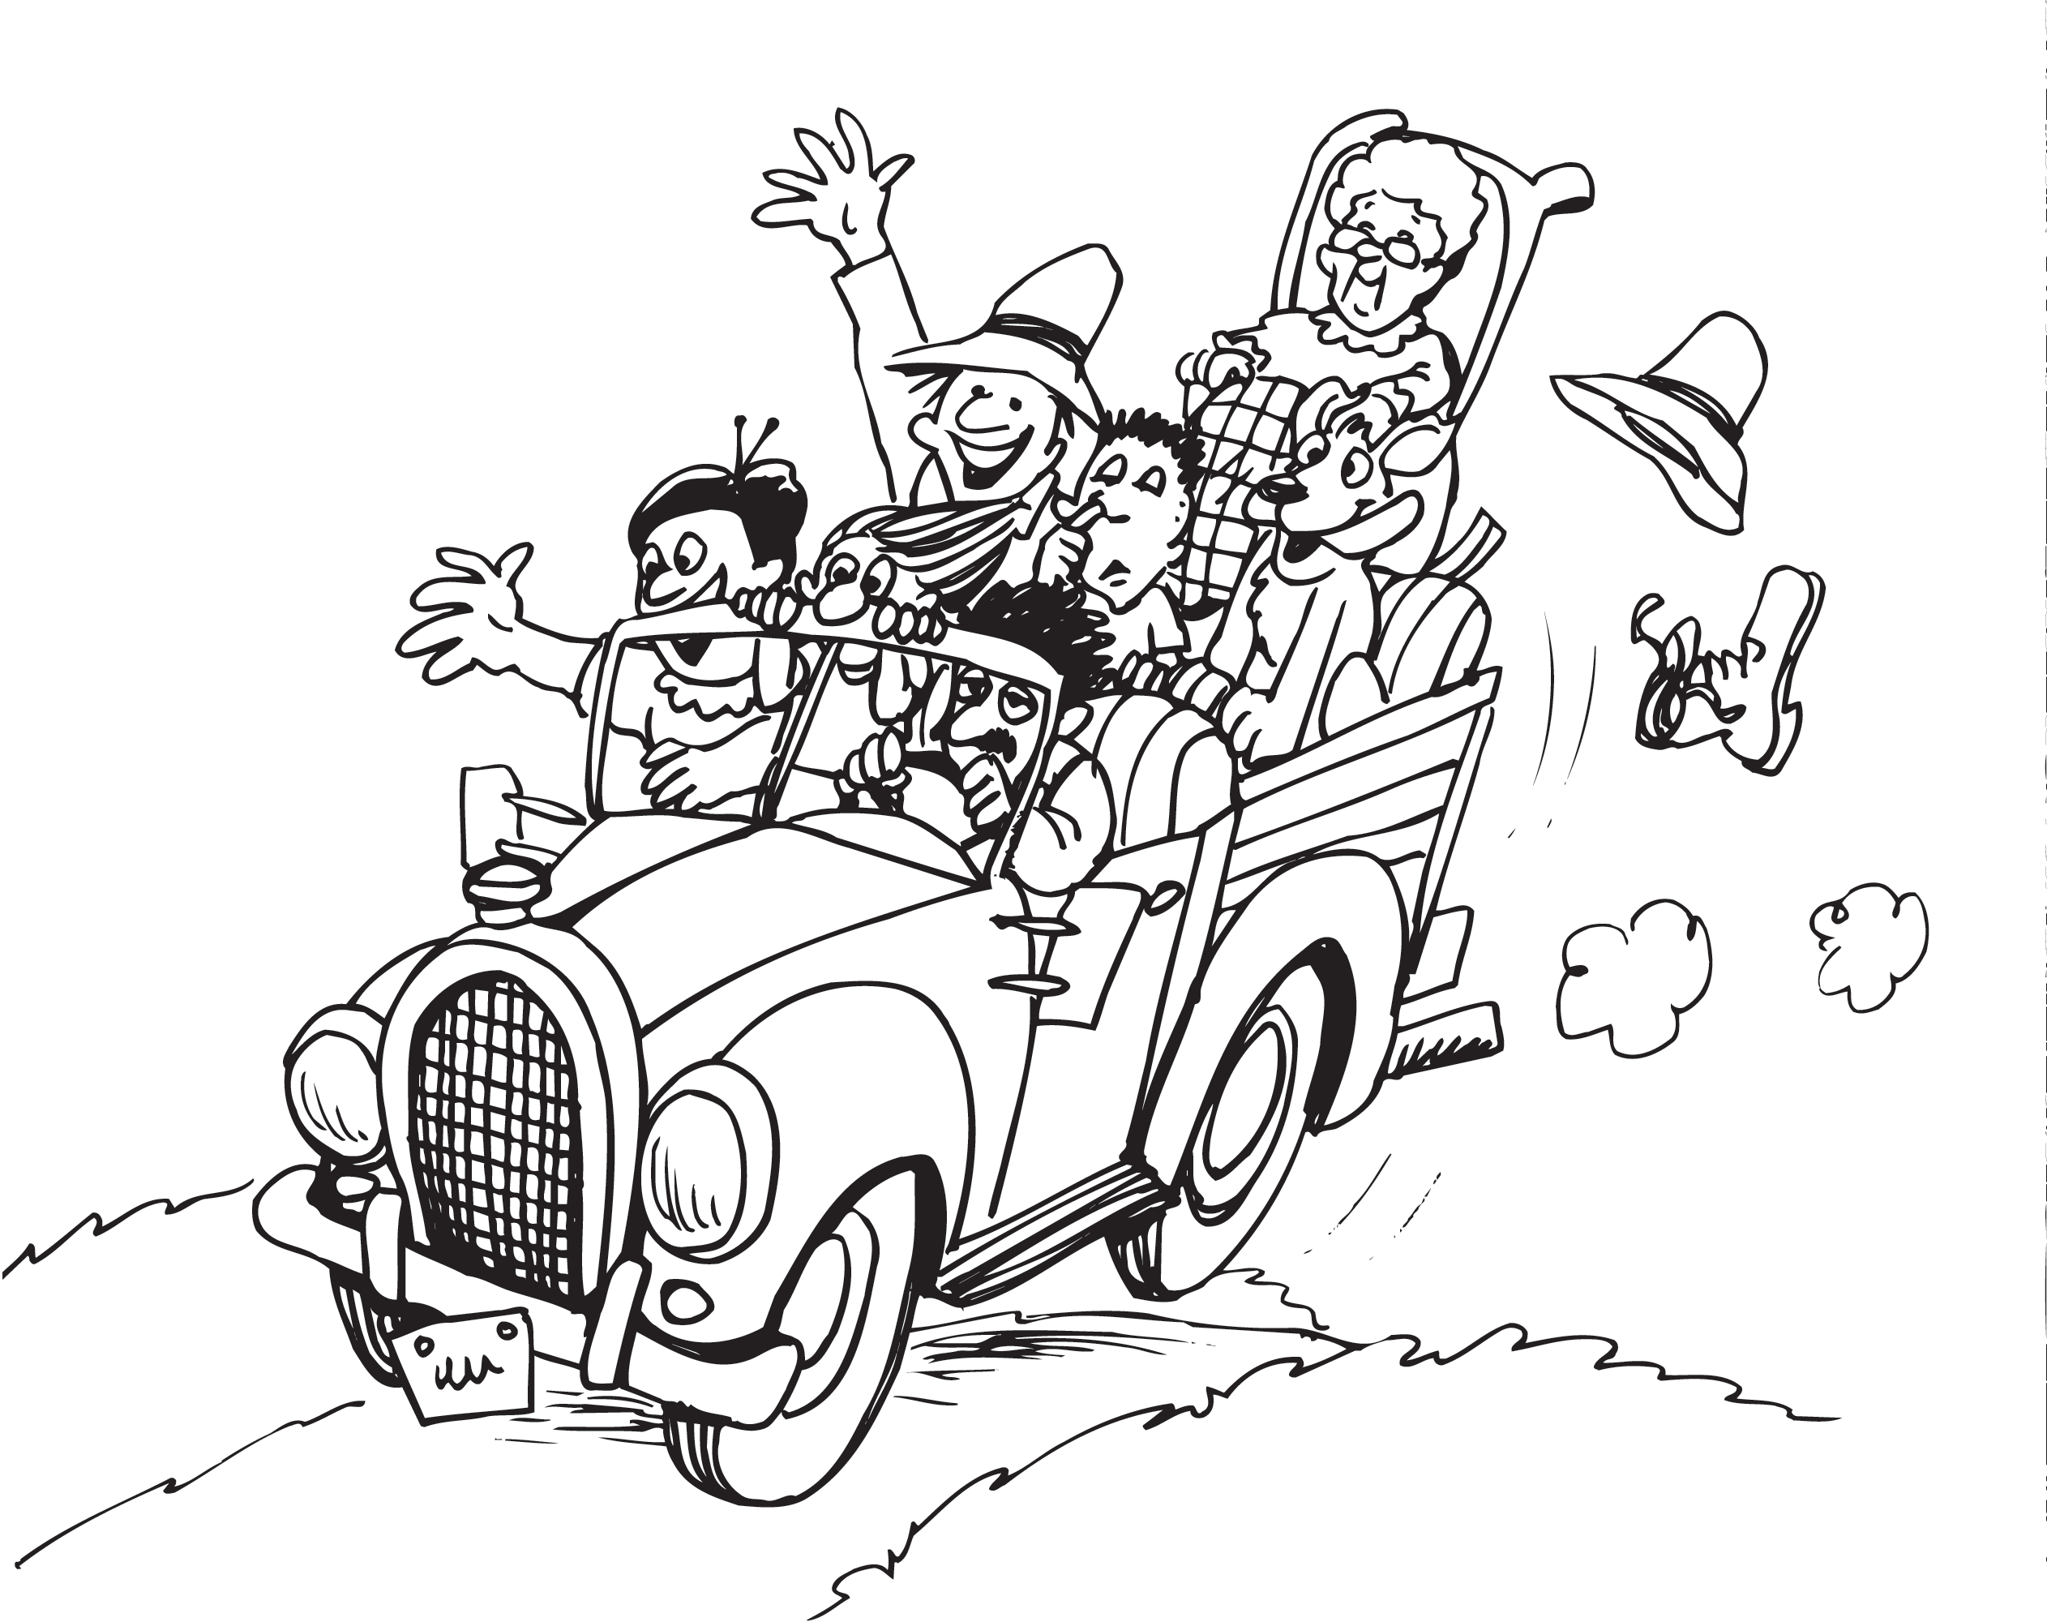
Learning about Grandchildren From God
The Blessing of Grandchildren
The encouragement of failure
Devotion to your own pursuits
“We don’t want to interfere”
Occasional “fun” visits
They can wear you out
Jesus Valued Children
“Let the children come to me; do not hinder them, for to such belongs the kingdom of God”
Mark 10:14
Royalty Free Clipart Image of a Family Traveling by Truck. Clipart. iCLIPART for Schools, Vital Imagery Ltd., 05-01-2009, https://schools.iclipart.com/download.php?iid=284323&tl=clipart. Accessed 07-10-2020

Slide 8
Learning about Grandchildren From God
Grandchildren as God’s Special Creation
Like all human beings, children are made in the image of God (Gen 1:27)
Knowing that God made our grandchildren in his image impacts how we think of them and how we seek to guide them in life.

Slide 9
Comment by Larry…
As more experienced followers of Christ, we grandparents are uniquely placed to come alongside these young image-bearers and train them to reflect on their lives with godly wisdom (p. 9)

Slide 10
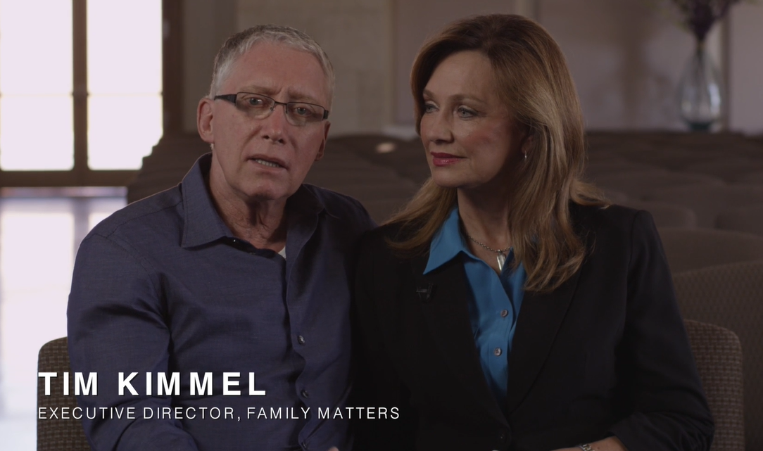
Resource
Family Matters
Tim and Darcy Kimmel
Grace Based Families- Dr. Tim Kimmel - Building Grace-Based Relationships

Slide 11
Psalm 78:1-4
Give ear, O my people, to my teaching; incline your ears to the words of my mouth!
I will open my mouth in a parable; I will utter dark sayings from of old,
things that we have heard and known, that our fathers have told us.
We will not hide them from their children, but tell to the coming generation the glorious deeds of the LORD, and his might, and the wonders that he has done.

Slide 12
Psalm 78:5-7
He established a testimony in Jacob and appointed a law in Israel, which he commanded our fathers to teach to their children,
that the next generation might know them, the children yet unborn, and arise and tell them to their children,
so that they should set their hope in God and not forget the works of God, but keep his commandments;
How far in the future is your longest planning goal or timeline?

Slide 13
Discussion Questions
What do you consider to be some of the blessings of being a grandparent?
What do you consider to be some of the challenges of being a grandparent?
How do you hope your grandparenting is different from your parenting?
What do you consider is the meaning of “tell” with respect to instructing on God’s Law and God? How can that be manifested?

Slide 14
Action Steps
Read Psalm 145 in a study Bible (The ESV Study Bible and NIV Study Bible are two of Larry’s favorites), reading the background notes, looking for truths about God that grandparents can pass along to their grandchildren.
Ask some of your friends who are also grandparents if they would join you in reading this book and discussing it together.

Slide 15
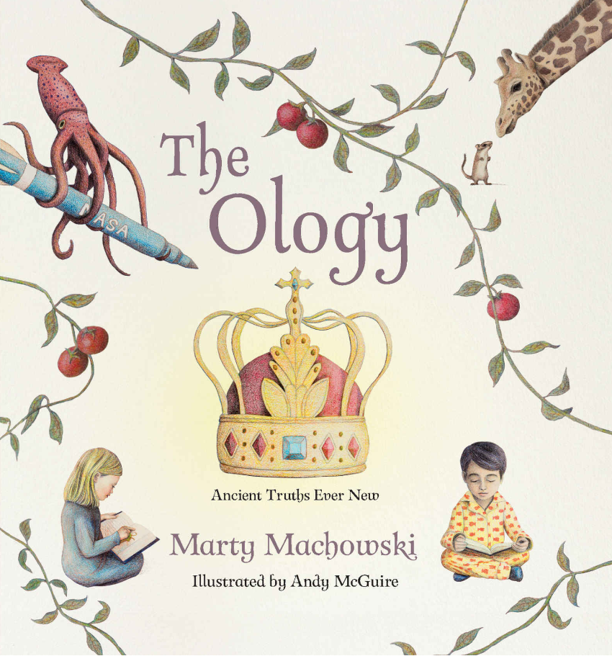
The Ology
The Ology by best-selling children's author Marty Machowski is a stunningly illustrated beginner's theology book to help kids of all ages understand who God is and how we, as his children, relate to him.
Arranged within a traditional systematic theological framework, each truth in The Ology is also connected to the larger redemptive story of Scripture. This storybook of systematic theology takes abstract concepts in the Bible and makes them easier to understand with the use of creative examples, illustrations, and analogies.
By Marty Machowski

Slide 16
The Bible Project
Bibleproject.com
BibleProject is a nonprofit ed-tech organization and animation studio that produces 100% free Bible videos, podcasts, blogs, classes, and educational Bible resources to help make the biblical story accessible to everyone, everywhere.

Slide 17
Deuteronomy 4:9
“Only take care, and keep your soul diligently, lest you forget the things that your eyes have seen, and lest they depart from your heart all the days of your life. Make them known to your children and your children’s children--
Deuteronomy lays great stress not on the priests or other religious leaders…
How many times is the word Grandparent found in the bible?

Slide 18
Josh Mulvihill
Biblical Roles
Need for a clear understanding
Culture
Unwritten rules
Extra non-essential role
To have an independent life at a distance
Christian Grandparents
Extremely important role
Pray and Play?
https://www.rightnowmedia.org/Training/Post/View/259328
0:00 - 9:24

